Slide 1
Dimension reduction
From modelling to visualization
Ali Madani
Farnoosh Khodakarami

Slide 2
Webinar outline
Introduction
Dimension reduction in practice
Why do we need dimension reduction?
What are the widely-used dimension reduction methods
Implementation in Python
Assumptions and parameters

Slide 3
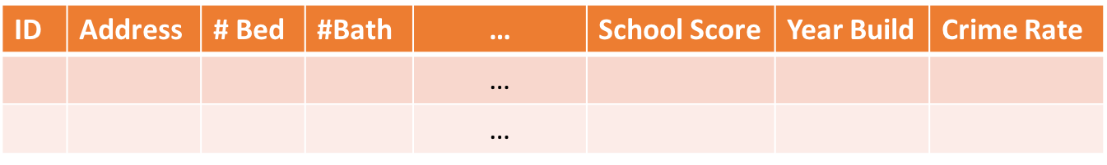
DataSets
Features(Attribute/variable)
Data records (samples)
# Features = Dimension of dataset
Notes:
Data Records related to Data Objects / Data points

Slide 4
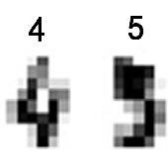

Number of dimensions in images
Number of dimensions (features) is equal to number of pixels if we use them directly as features of our models.
8*8=64
2048*1536=3,145,728
UCI ML hand-written digits
http://www.kabu-load.net/
Notes:
algorithms are simply harder to design in high dimensions and often have a running time exponential in the dimension
running time • overfitting • number of samples required

Slide 5
Why do we need to reduce number of dimensions?
May help to eliminate irrelevant features or reduce noise
Notes:
algorithms are simply harder to design in high dimensions and often have a running time exponential in the dimension
running time • overfitting • number of samples required

Slide 6
Why do we need to reduce number of dimensions?
May help to eliminate irrelevant features or reduce noise
Dimension 2
Dimension 1
Notes:
algorithms are simply harder to design in high dimensions and often have a running time exponential in the dimension
running time • overfitting • number of samples required

Slide 7
Why do we need to reduce number of dimensions?
May help to eliminate irrelevant features or reduce noise
Dimension 2
Dimension 1
Notes:
algorithms are simply harder to design in high dimensions and often have a running time exponential in the dimension
running time • overfitting • number of samples required

Slide 8
Why do we need to reduce number of dimensions?
May help to eliminate irrelevant features or reduce noise
Reduce Time and Memory in computations
Notes:
algorithms are simply harder to design in high dimensions and often have a running time exponential in the dimension
running time • overfitting • number of samples required

Slide 9
Why do we need to reduce number of dimensions?
May help to eliminate irrelevant features or reduce noise
Reduce Time and Memory in computations
Allow data to be more easily visualized
We can imagine things in 3D.
We can visualize, in an easy to interpret way, up to 2D.
Notes:
algorithms are simply harder to design in high dimensions and often have a running time exponential in the dimension
running time • overfitting • number of samples required

Slide 10
Dimensionality Reduction
feature1
feature2
feature3
feature4
feature5

Slide 11
Feature Selection
Dimensionality Reduction
feature1
feature2
feature3
feature4
feature5
feature2
feature4

Slide 12
Feature Extraction
New feature1
New feature2
Dimensionality Reduction
feature1
feature2
feature3
feature4
feature5

Slide 13
Feature Extraction
Feature Selection
New feature1
New feature2
Dimensionality Reduction
feature1
feature2
feature3
feature4
feature5
feature2
feature4

Slide 14
Example of Feature Extraction
Risk of Diabetes
 | Weight(lb) | Hight(ft)
Joe | 170 | 6’
James | 150 | 5’3’’

Slide 15
Example of Feature Extraction
Risk of Type 2 Diabetes
 | Weight(lb) | Hight(ft)
Joe | 170 | 6’
James | 150 | 5’3’’
Is risk of type 2 diabetes higher for Joe?

Slide 16
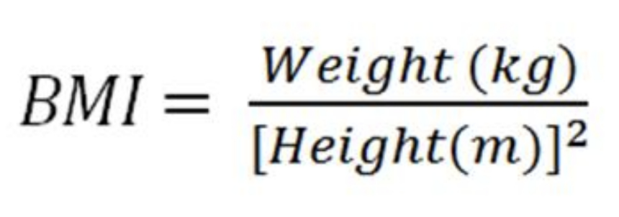
Example of Feature Extraction
Risk of Type 2 Diabetes
 | Weight(lb) | Hight(ft)
Joe | 170 | 6’
James | 150 | 5’3’’
 | BMI
Joe | 23.1
James | 26.6

Slide 17
Example of Feature Extraction
Risk of Type 2 Diabetes
 | BMI
Joe | 23.1
James | 26.6
Risk of type 2 diabetes is higher for James
Ganz, Michael L., et al. "The association of body mass index with the risk of type 2 diabetes: a case–control study nested in an electronic health records system in the United States." Diabetology & metabolic syndrome 6.1 (2014): 50.

Slide 18

1
Principal Component Analysis (PCA)
Feature Extraction

Slide 19
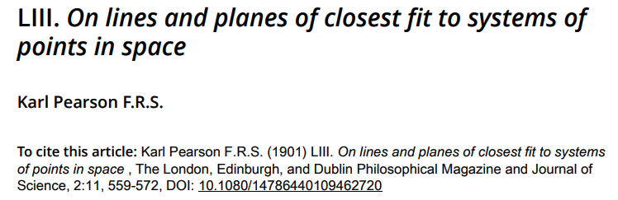
1
Principal Component Analysis (PCA)
Feature Extraction

Slide 20
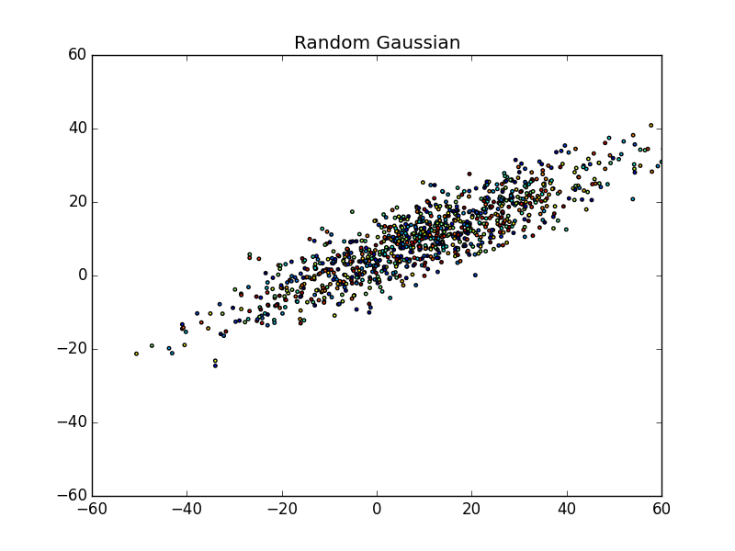
1
Principal Component Analysis (PCA)
Feature Extraction
Dimension 2 (Feature 2)
Dimension 1 (Feature 1)

Slide 21
1
PCA: Principal Component Analysis
New Dimension 1 (New Feature 1)
Feature Extraction
Dimension 2 (Feature 2)
New Dimension 2 (New Feature 2)
Dimension 1 (Feature 1)
Notes:
Rotate the Axis to the new coordinate system

Slide 22
PCA: Principal Component Analysis
Features(Attribute/variable)
Feature 1
Feature 2
Feature 3
Feature P-2
Feature P-1
Feature P
Data records (samples)
Principle components
From M features to K PCs
PC1
PC2
PC3
PCK-2
PCK-1
PCK
K <= min{P,N}
Data records (samples)

Slide 23
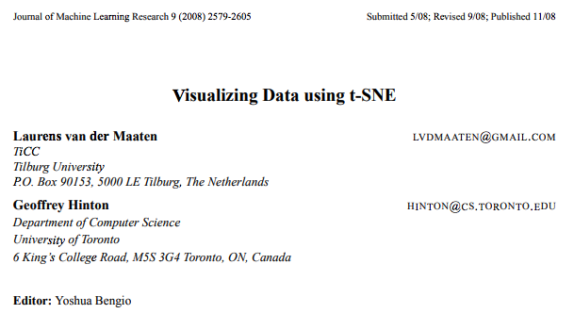
2
t-SNE: t-Distributed Stochastic Neighbor Embedding
Feature Extraction
Amazing GitHub page
https://lvdmaaten.github.io/tsne/

Slide 24
t-SNE: t-Distributed Stochastic Neighbor Embedding
P-dimensional space
2D space
Mapping that preserves local structure of data
Neighbors remain neighbors
Dimension 2
No meaning in large distances
Dimension 1
The embedding does not preserve global structure of data

Slide 25
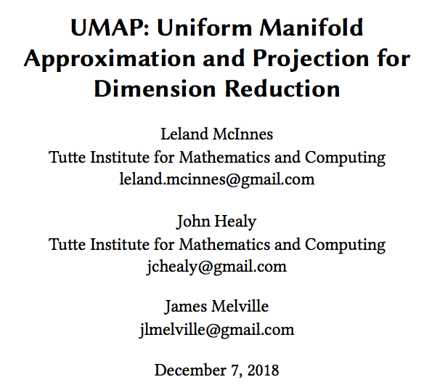
3
UMAP: Uniform Manifold Approximation and Projection
Feature Extraction
Amazing GitHub repository
https://github.com/lmcinnes/umap

Slide 26
1
PCA: Principal Component Analysis
Feature Extraction
2
t-SNE: t-Distributed Stochastic Neighbor Embedding
3
UMAP: Uniform Manifold Approximation and Projection

